Slide 1

Identifying Medical Misinformation in Social Media using Machine Learning Techniques in Bangladesh
Emon Sarker | Parinda Rahman | Mahima Ahsan
Up Next: Motivation

Slide 2

Motivation
During the pandemic we have seen a plethora of medical information flooding social media platforms
The source of information ranged from the CDC, WHO to regular people
The medical data found online is a mix of information & misinformation
This can be harmful to the regular person
We need a reliable way to label medical misinformation
Up Next: Brief

Slide 3

Brief about topic
Related Works
Khanday et al., 2021 utilised machine learning to classify medical misinformation regarding COVID-19.
Hlaing et al., 2020 used synonym-based feature extraction method and three different classifiers based on multidimensional dataset to classify fake news from facebook posts.
Social network and online news media are popular for sharing information.
Medical information is often a large majority of the social media or news content in Bangladesh.
Medical misinformation can have devastating impacts.
Machine Learning can employed to classify medical misinformation
Up Next: Flow Diagram

Slide 4
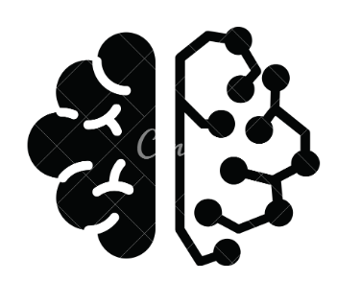

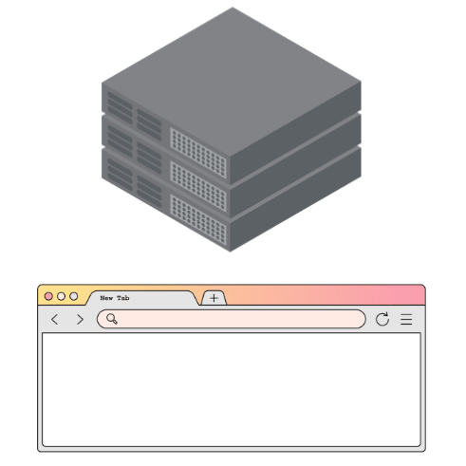


Flow Diagram
Social media icon
Test data
Whatever whatever
Misinformation
stuff
Training Model
EDA & Preprocessing
Data Collection
Deployment
Evaluation
Up Next: Dataset

Slide 5
Dataset Collection Features
These are the attributes we will be collecting manually from social media
Text | Translation | Platform | Category | Type of source | Name of source | Page Description
… | … | … | … | … | … | …
Positive Reaction Count | Neutral Reaction Count | Negative Reaction Count | Keywords for Search | Translated Keywords for Search | Class Label | Validation Source | Type of Source
… | … | … | … | … | … | … | …

Slide 6
Dataset Sample
Text | Translation | Platform | Category | Type of source | Name of source | Page Description
ডায়াবেটিস গাছের পাতা খান, ডায়াবেটিস নিয়ন্ত্রণে রাখুন | Eat the leaves of diabetes tree, keep diabetes under control | Facebook | noncommunicable diseases | Unverified Page | medica tea | We are manufacturing and marketing 100 % organic herbal products. Supported by Market development of medicinal product project (UDPS). Funded by IFAD and PKSF. These products are effective to controlling disease.
Positive Reaction Count | Neutral Reaction Count | Negative Reaction Count | Keywords for Search | Translated Keywords for Search | Class Label | Validation Source | Type of Source
9 | 8 | 0 | ডায়াবেটিস গাছ | diabetes plant | Misinformation | WHO (World Health Organization) | United Nations agency

Slide 7
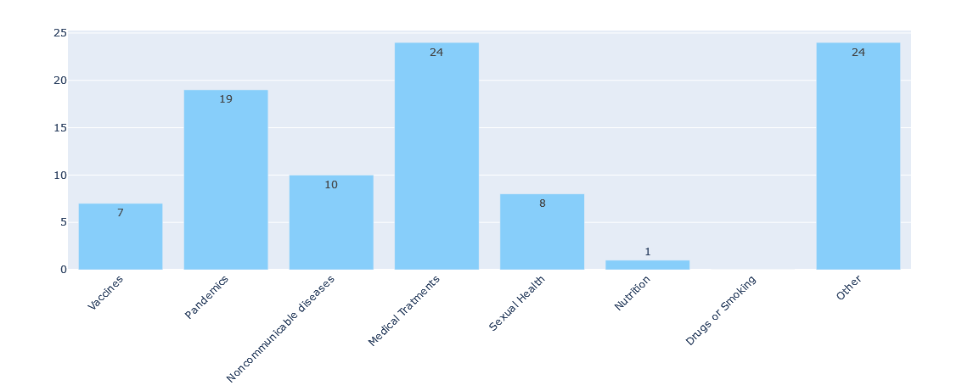
Stats for nerds* *(with 93 samples)
Fig 1: Data points per Category

Slide 8
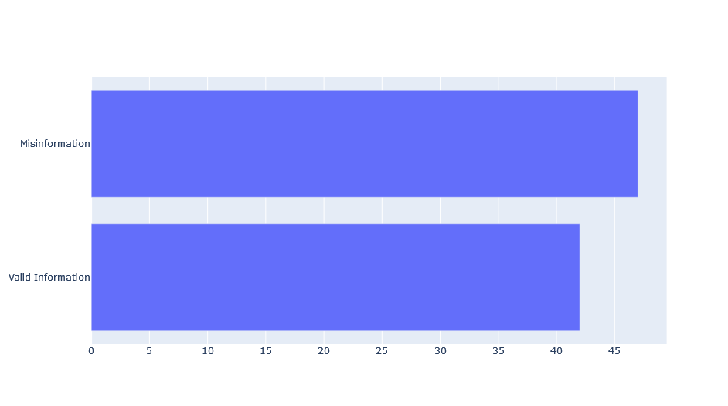
Stats for nerds cont.* *(with 93 samples)
Fig 2: Dataset split between Information and Misinformation

Slide 9
Feature Explanation
Legend | Nominal Numerical Categorical
Text Nominal -The main sentiment of scrapped data
Translation Nominal -Manually translated ”Text” (Bangla to English)
Platform Categorical -Which social media platform
Category Categorical -Medical misinformation category (eg. pandemics, vaccines)
Type of source Categorical -Newspaper, person, platform, etc-categorical
Name of source Nominal -The name of the source
Page description Nominal -Biography description of the page

Slide 10
Feature Explanation cont.
Legend | Nominal Numerical Categorical
Positive Reaction Count Numerical -Likes, wow, hearts and affirmative words
Negative Reaction Count Numerical -Haha, Angry and sarcastic/combative words
Neutral Reaction Count Numerical -Irrelevant reactions
Keywords for search Nominal -What was used to search for data
Translated Keywords for Search Nominal -Translation of the keywords used, Bangla to English
Class label Categorical -Misinformation or Information
Validation Source Nominal -Manually verified source used to validate/invalidate the given class label
Type of Source Categorical -Is it a verified page, unverified page, person

Slide 11
Dataset after Feature Engineering
- Features to be dropped - Features to be dropped
Text | Translation of Text | Platform | Category | Type of source | Name of source | Page Description
 |  |  | (Needs expert validation)
Positive Reaction Count | Neutral Reaction Count | Negative Reaction Count | Keywords for Search | Translated Keywords for Search | Class Label | Validation Source | Type of Source
Up Next: Problem Type

Slide 12
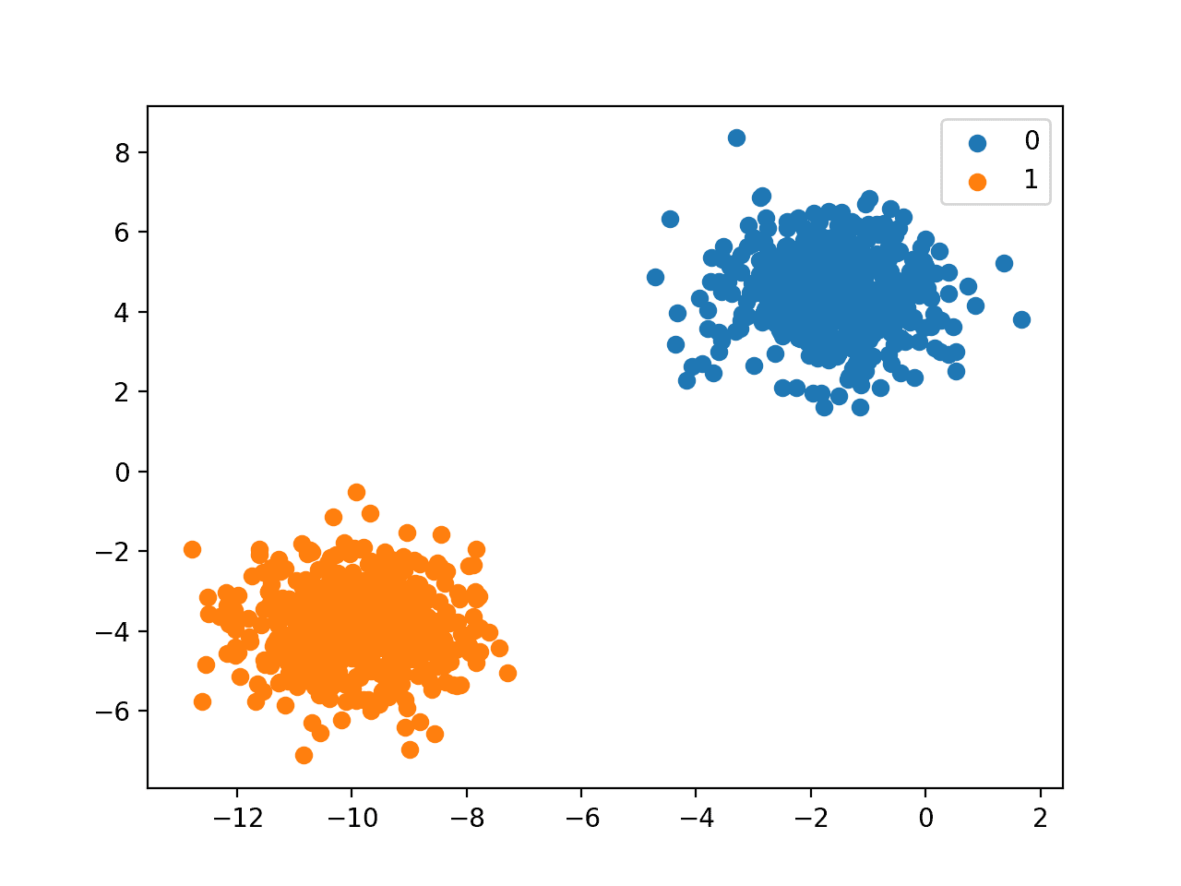
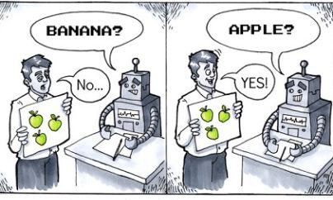
The training to be performed is supervised
The task our model will perform is classification
Up Next: Software Architecture

Slide 13
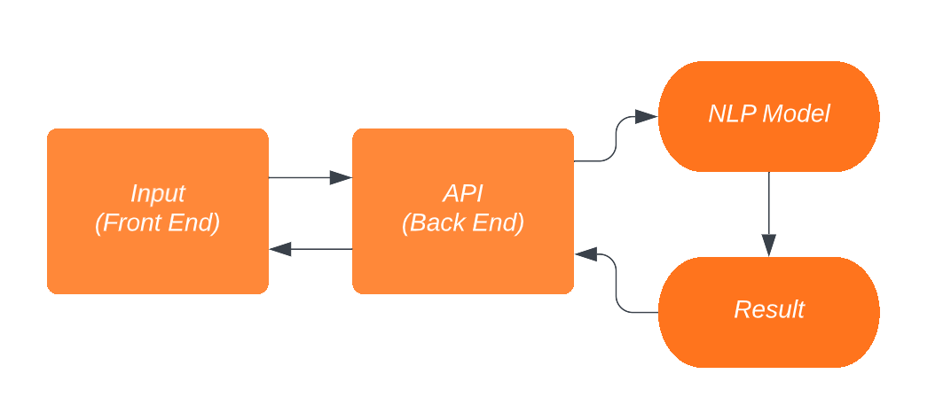
High Level Software Architecture
Up Next: Gantt Chart

Slide 14
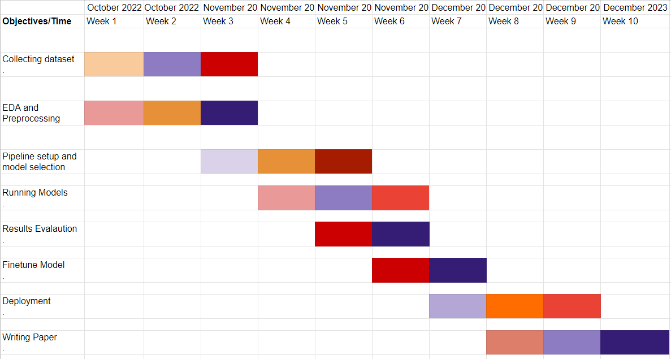
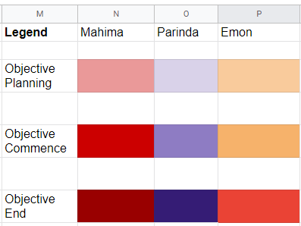
Gantt Chart

Slide 15
References
Hlaing, M.M.M. and Kham, N.S.M., 2020, February. Defining news authenticity on social media using machine learning approach. In 2020 IEEE Conference on Computer Applications (ICCA) (pp. 1-6). IEEE.
Khanday, A.M.U.D., Khan, Q.R. and Rabani, S.T., 2021. Identifying propaganda from online social networks during COVID-19 using machine learning techniques. International Journal of Information Technology, 13(1), pp.115-122.

Slide 16
THANK YOU
Questions?

